Slide 1
Streamlining Certiﬁcation Management: CertiTrack

Slide 2
Agenda
Problem being Addressed
Proposed Solution
Tech Stack
Target Consumers and Competitors
Application Features
Future Scope
Contributions and Learnings
App Demo & Conclusion

Slide 3
Problem being Addressed
Within our organization, employees who aspire to obtain certifications often face challenges in identifying suitable mentors or accessing the necessary resources to assist them on their certification path.
This lack of guidance and resources delays their professional development and may result in missed opportunities for both the individuals and the company.
How can we facilitate a more seamless and efficient process for employees seeking certification support within the organization?

Slide 4
Proposed Solution
The CertiTrack project aims to simplify the certification process for employees while encouraging a culture of mutual support and learning. This will be achieved through a user-friendly web application designed to serve several key functions:
1. Certification Tracking:
The application will enable employees to easily keep tabs on their certifications. They can see which certifications they've completed and which ones they're working towards.
2. Peer Guidance & Mentor Matching:
Employees will be able to connect with their colleagues who have already completed specific certifications. This feature encourages knowledge sharing and mentorship within the organization.
To facilitate guidance, the application will help employees find suitable mentors within the company who can assist them on their certification journey.
3. Q&A Forum:
An interactive Q&A forum will be available for employees to ask questions and seek answers related to certifications. This creates a collaborative environment for problem-solving.
4. Learning Resources:
The application will house a repository of valuable materials and learning paths that employees can access to enhance their certification preparation.
5. Managerial Oversight:
Managers and team leads will have the capability to assign and track the certification progress of their team members, streamlining the certification management process.

Slide 5

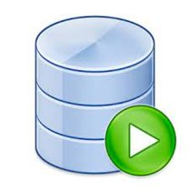



Tech Stack
SQL Agent​

Slide 6
Target Consumers and Competitors
Consumers:
Internal Employees: Employees seeking certifications and professional development.
Managers and Team Leads: Those managing teams and tracking certification progress.
Organizations: The company itself, benefiting from a more skilled and certified workforce.
Current Competitors:
LinkedIn
Stack Overflow
Quora

Slide 7
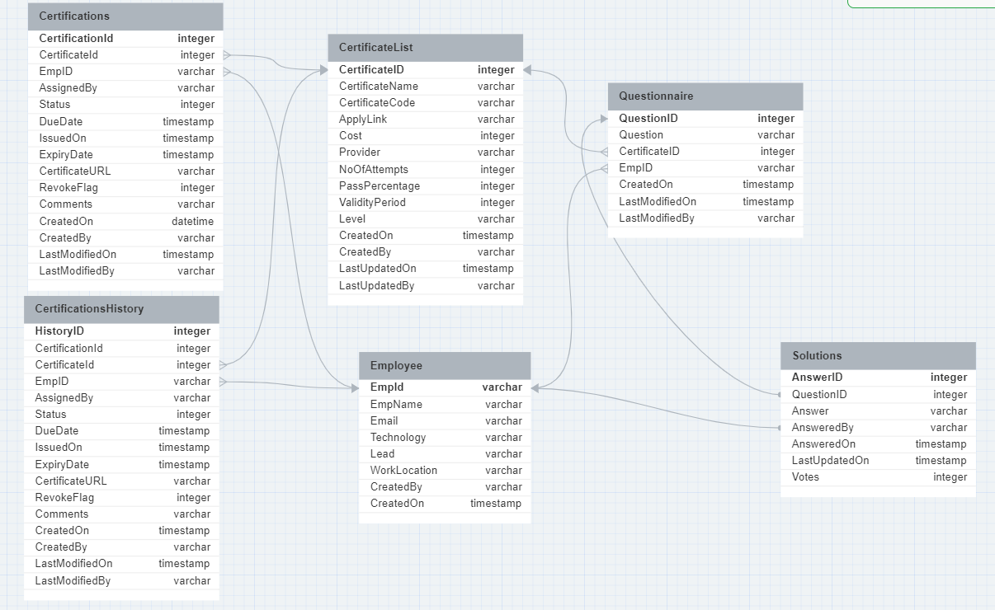
Data Model

Slide 8
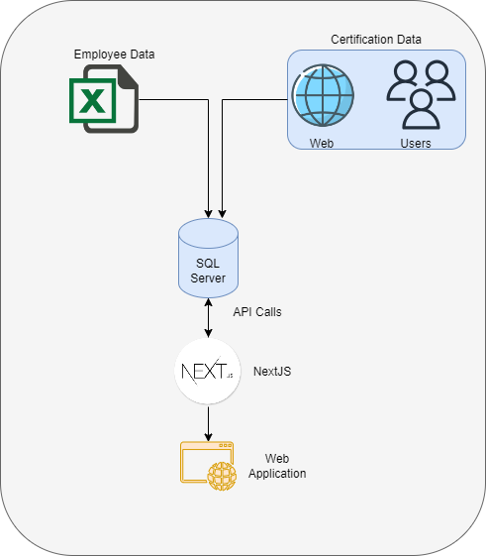
Architecture

Slide 9
Implemented Procedures
GET Procedures
GetCompletedCertificationsList GetCertifiedPeople(@CertificateID) GetQuestions(@CertificateID) GetAnswers(@QuestionID) GetMyCertifications(@EmpID) GetReportersCertifications(@EmpID) GetCertificationHistory(@CertificateID,@EmpID) GetReportees(@EmpID) GetCertificateDetails(@CertificateID)
Insert Procedures
AddCertificate(@all Parameters from frontend) AddQuestion(@CID,@Question,@EmpID) AddAnswer(@QuestionID,@Answer,@EmpID)
Update Procedures
UpdateCertificate(@CID ,@Type, and other fields) UpdateQuestion(@QuestionID ,@Question, @EmpID) UpdateAnswer(@AnswerID,@Type ,@Answer, @EmpID)

Slide 10
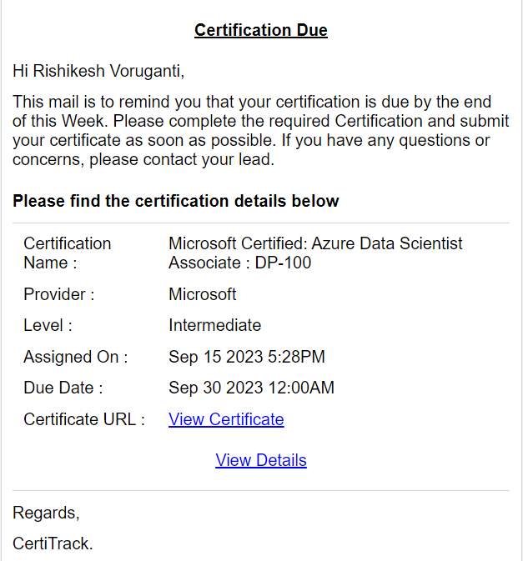
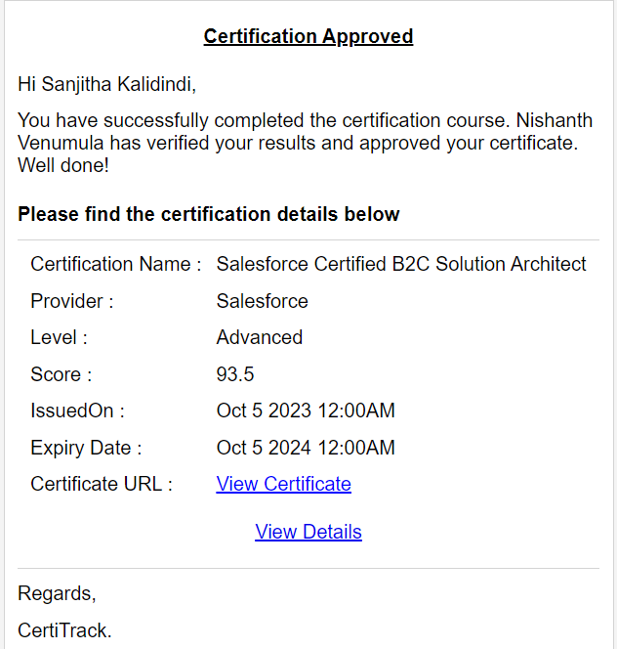
Email Notifications
Email notifications for Revoke, Approval, and completion
Email notifications for Expiry and due date

Slide 11
Remaining Tasks
Develop Front End Application
Create views to provide data for reporting( Optional )
Partial testing done (26-09-2023)
Working on creating APIs for the react application(25-09-2023)
Authentication
Blockers
SQL Agent jobs for automating Email notifications
Power BI licence for reporting
Database Mail access to send mails
Resources for front end application

Slide 12
Conclusion
Created stored procedures in SQL Server to implement core features
Designed dynamic emails to notify employees about various actions
Explored different approaches to develop front end application
Communicated frequently to assign tasks and ensure completion
Used Azure data studio to manage git actions for collaboration

Slide 13
Thank You

